Slide 2
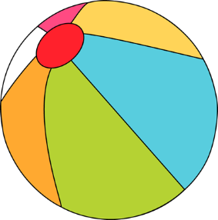
Sunday | Monday | Tuesday | Wednesday | Thursday | Friday | Saturday
 |  |  | 1 | 2 | 3 | 4
5 | 6 | 7 | 8 | 9 | 10 | 11
12 | 13 | 14 | 15 | 16 | 17 | 18
19 | 20 School T-Shirt sale begins $10-$15 | 21 Parent meeting 4pm Enrichment registration begins | 22 | 23 | 24 | 25
26 | 27 | 28 | 29 | 30 Family Night – Chili’s 5pm | 31
BridgePrep Academy of Duval
Our Mission Statement
BridgePrep Academy believes every child learns best in a safe, nurturing and stimulating environment where high academic expectations, self-esteem, good character and an appreciation for the arts are promoted. BridgePrep Academy’s mission is to provide a challenging academic curriculum that will encompass an enriched Spanish language program, technology and experiences that will enable students to develop in all areas.
BridgePrep Academy’s goal is to educate well rounded individuals and enable students
to reach their maximum potential.
www.BridgePrepDuval.com
https://www.facebook.com/BridgePrepAcademyDuval/
Make sure to check the school website for all
upcoming events and updates
www.bridgeprepduval.com/
K-3 at 8:000am-10:30am
4-5 at 11:00am-12:30pm
6-7 at 1:00-2:30pm
School Hours
Kinder- 5th grade
8:30am-3:30pm
6th and 7th grade
8:15am- 3:15pm
Snack Sales
School T-shirt Day
with uniform bottom
Snack Sales
NO UNIFORM $2
Middle School Lead Day
School T-shirt Day
with uniform bottom
Student of
the Month
Recognition
BridgePrep Academy
of Duval
6400 Atlantic Blvd. Jacksonville, FL 32211 (904) 694-2660
Snack Sales

